Slide 1

Data Science Project Report
DS
PROJECT
A detailed exploration of multiple datasets for meaningful insights

Slide 2
Introduction
I will be working on five data science
projects:
COVID-19 Clinical Trials EDA
Netflix Data Analysis and Visualization
OCD Patient Dataset Exploration
Google Play Store Apps Data Analysis
Chatbot Machine Learning Project
The aim is to extract insights, create visualizations, and apply machine learning models.

Slide 3
Project Overview
DS
COVID-19 Clinical Trials: Analyzing clinical trials data for insights into treatments.
Netflix Data: Exploring user engagement, ratings, and trends.
OCD Patient Dataset: Examining treatment outcomes and patient demographics.
Google Play Store Apps: Analyzing app ratings, reviews, and category trends.
Chatbot ML Project: Building and training a machine learning model to manage conversations.

Slide 4


Data Description and Preparation
COVID-19 Clinical Trials: Study titles, trial status, patient demographics.
Netflix Data: Movie titles, genres, user ratings.
OCD Dataset: Patient age, treatment type, recovery success.
Google Play Store Apps: App category, ratings, downloads.
Chatbot ML Project: User conversations, intents, responses.

Slide 5
Key Performance Indicators (KPIs)
COVID-19 Trials: Success rate, patient distribution.
Netflix Data: Top-rated movies, highest watched genres.
OCD Dataset: Treatment success, demographics of recovery.
Google Play Store Apps: Top-rated apps, most downloaded categories.
Chatbot ML: Model accuracy, number of successful conversations.

Slide 6
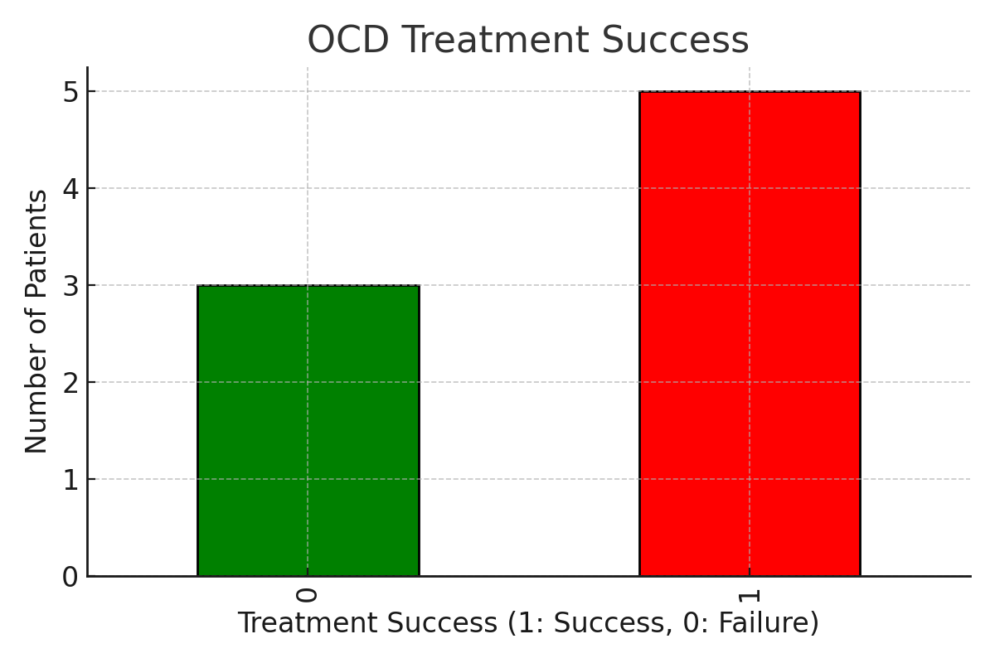
Mockup Dashboard
A visual dashboard summarizing key insights:
Bar chart: COVID-19 trial success rates.
Pie chart: Netflix genre distribution.
Histogram: OCD patient recovery.
Bar chart: Top Google Play categories.
Line graph: Chatbot accuracy over time

Slide 7

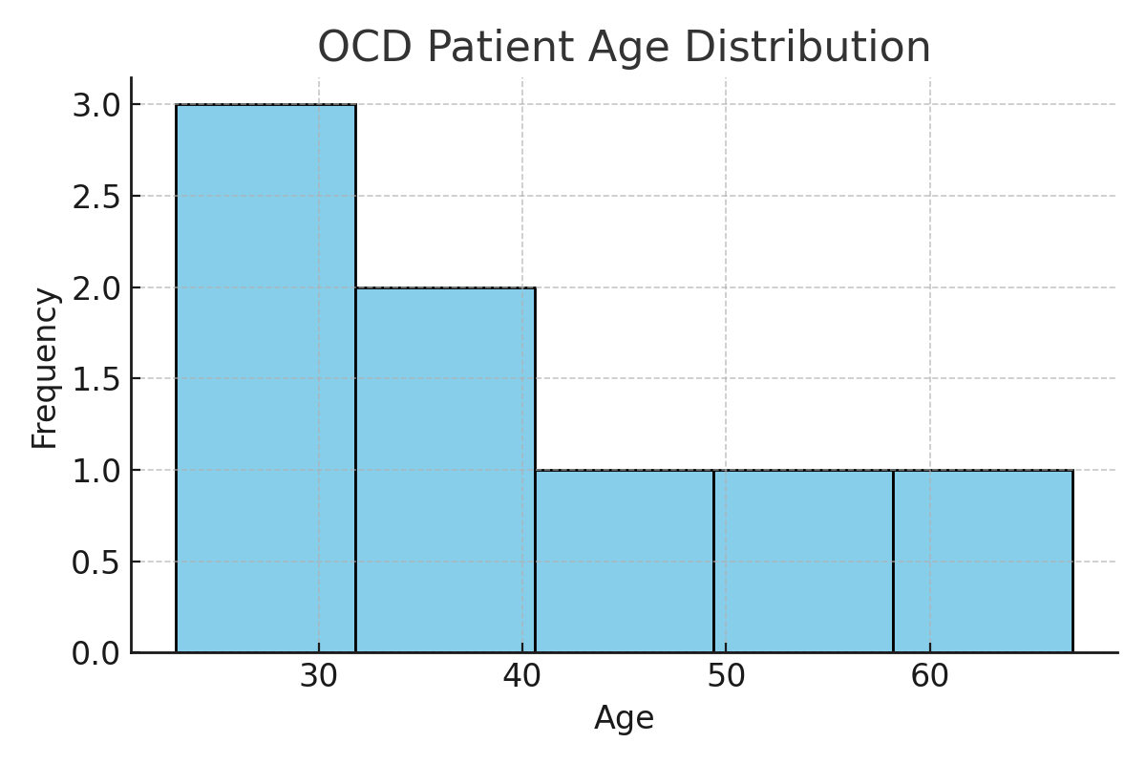
Data Cleaning and Preparation Process
Steps for cleaning the data in each dataset:
COVID-19 Trials: Handling missing values.
Netflix: Normalizing movie genres and ratings.
OCD: Removing outliers and filling missing fields.
Google Play Apps: Standardizing app categories.
Chatbot ML: Preprocessing user intents and responses.

Slide 8

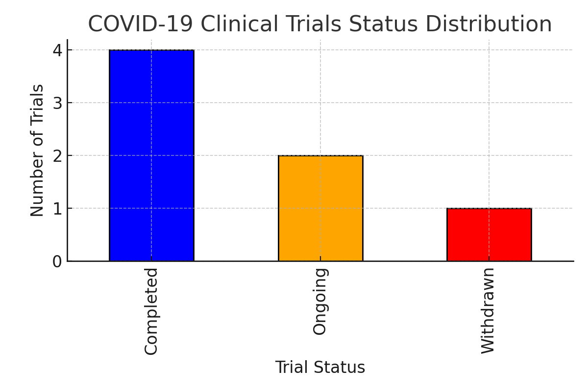
Tables and Charts
Tables displaying insights:
Top COVID-19 trials by success rate.
Highest-rated Netflix movies.
Most downloaded Google Play apps.
Bar charts and pie charts to complement the data.

Slide 9
Data Visualizations and Plots
Visualizations:
COVID-19 Trials: Line chart of successful vs. ongoing trials.
Netflix: Bar chart of top 10 rated shows.
Google Play Apps: Pie chart showing app category distribution.
Chatbot ML: Line plot showing model improvement over iterations.

Slide 10
Model Building (Chatbot ML Project)
Steps for building the machine learning model:
Data collection (user conversations).
Preprocessing and intent classification.
Training, testing, and evaluation.
Conversation ID | Intent | Response Accuracy (%)
001 | Greeting | 98
002 | Order Inquiry | 95
003 | Complaint | 92

Slide 11
Final Insights
Key findings from each dataset:
COVID-19 Trials: Treatment success patterns.
Netflix: Viewer engagement trends.
OCD Dataset: Factors influencing treatment outcomes.
Google Play: Top app categories.
Chatbot ML: Model performance and future improvements.

Slide 12

Thank You.
DS
PROJECT
DS
PROJECT
Rozina Pathan
8821855794
rozina8617@gmail.com

